Slide 1
K-Best Candidates Reference-point NSGA-III
Algorithm By Sina Azartash
Notes:
I will be explaining what this name means shortly. This is a name I came up with to describe my modification to the R-NSGA-III algorithm.

Slide 2
Main Ideas

Slide 3

NSGA-III
Based on NSGA-II → Evolutionary Multi-Objective Optimization
Aim1: to Approximate the Pareto Front
Aim2: to obtain non-dominated solutions
Up to 3 objectives
Non-Dominated Sorting Genetic Algorithm III
Up to 15 objectives
Evolutionary Many Objective Objective Optimization (EMaO)
Discovered 2014
COIN-Lab: Michigan State University
Author: K. Deb
Also the author of NSGA-I and NSGA-II
Kalyanmoy Deb
coin-laboratory.com
Notes:
Non-dominated solutions lie on the true pareto front. Hopefully, our approximation of the pareto front contains non-dominated solutions.

Slide 4
Reference point NSGA-III
Currently: NSGA-III
Run NSGA-III algorithm to obtain approximation of Pareto Front (approx PF)
Choose preferred solutions from solutions in approx PF
Problem:
can be computationally expensive
There can be a large number of solutions to choose from in the approx PF
Proposed Solution: R-NSGA-III → introduce a prior
Choose preferred area of solutions
Run NSGA-III only on preferred space
Result
Reduced computation of algorithm
less effort choosing a solution from approx PF
Notes:
Of course first, obtain objective function

Slide 5
K- Best Neighbors - R- NSGA-III
Currently: R-NSGA-III
Calculates a partial set of the approx PF
Only one study done, Discovered 2018 by K. Deb’s lab
Problem compared to NSGA-III:
Returns less optimal solutions → less accurate PF approximation
Less diversity → less representative of the front
Hypothesis: KBN-R-NSGA-III
Increased diversity
More optimal solutions in approx PF
Result → Unsuccessful
Less diversity
Less optimal solutions

Slide 6
Related Work Overview

Slide 7
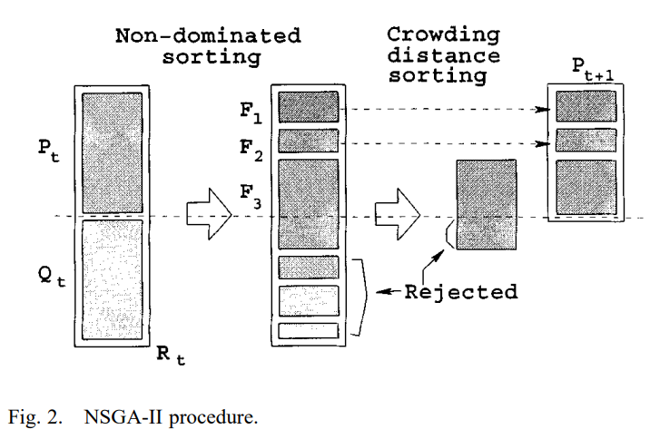
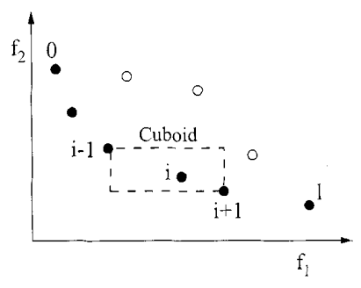
NSGA-II
Non-dominated Sorting→ rank according to pareto domination
Each individual represents a solution
How many times does an individual dominates another? → int
By who has it been dominated? → set of individuals
Categorizing of different domination ranks → F1, F2, F3
Crowding Distance → ranks points according to distance between neighbors
Decide which individuals become parents for next generation
Promotes diversity and helps avoid local optima
Individuals within the same domination rank are sorted according to crowding distance
Average distance between two points along each objective
Notes:
Every individual represents a solution.

Slide 8
NSGA-II Problems
Computationally Intractable with an increasing number of objective functions:
→The hyperdimensional objective space becomes large and complex
Too many solutions per generation
Large population size per rank
all solutions in a rank are non-dominated
Exponential increase in number of comparisons in non-dominated sorting and crowding distance
Individuals become very spread out
Parents farther away from each other less reliably produce offspring that can dominate the parent
Decreased quality of approx PF

Slide 9
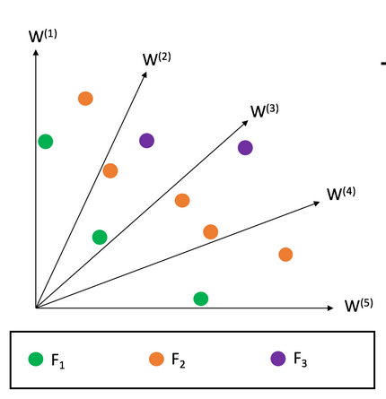
NSGA-III
Reference Vectors → discretize the front
Each reference vector represents one region
Reference vector are predefined to start from origin and point to a normalized front hyperplane
Each region should have at least one individual
Niche Preservation Operator → associate individual with a reference vector
Individual with closest projected perpendicular distance is ‘associated’
Result → less candidates, less comparisons, more diversity
Notes:
Every individual represents a solution.

Slide 10
R-NSGA-III
Generates preferred partial set of approx. PF
Aspiration Point:
Encodes prior information
Aspiration Points point to preferred subspace
Reference points are constructed around aspiration point
Reference vector = Reference point, Aspiration vector = aspiration point
Each point contains a vector of objectives

Slide 11
Generating Reference Vectors
Uniform Design: Reference vectors need to be well spaced on hyperdimensional plane to fairly represent the front
Number of reference vectors controlled by parameter
Normal Boundary Intersection: R-NSGA-III
each reference point aims to have an identical distance away from other references
Set of all reference vectors on normalized hyperplane sum to one
Problem → with multiple objectives, the references increasingly point to exterior of the objective hyperdimensional space
Shrinking Factor μ: R-NSGA-III Well spaced points are shrunk by a linear factor, μ, around aspiration point

Slide 12
Niche Preservation Operator
Map each reference point to an individual
Shortest euclidean distance to reference point → “rank one”
One “rank one” per individual
Eliminate any individuals that is near any rank one point.
Near = within ε distance of a “rank one”
If individual is near, then discard individual from algorithm
If there are any remaining unranked individual, repeat 1 and 2 for “rank two, three, etc.”
End when all individuals are eliminated or ranked
Notes:
This was done to reduce the computation effort, but since we are choosing a partial set, we can relax this

Slide 13
Problem

Slide 14
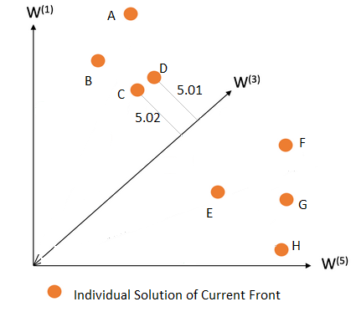
Good candidates might be eliminated
R-NSGA-III niche preservation operator only considers the closest point as ranked.
Other candidates that are close to the reference vector, and within ε distance to the rank one are eliminated
Why does this matter? This could:
Encourage a bias where certain objective functions are weighed more heavily
More “in-bred” crossover
less variation of offspring
less opportunity to dominate parents
Above, individual C gets eliminated even though it was basically same quality candidate as D

Slide 15
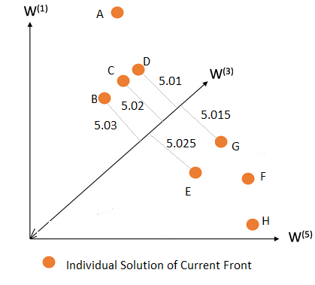
Picking the best candidate
What about instances when all the candidates are very close to the reference vector? Does it still matter?
Points with similar distances might actually be very different
Distance from a reference point is the overall distance per objective functions
As the number of objective functions increase, the likelihood that two points with the exact same distance differ greatly increases
Conclusion:
Nearest individual to the reference vector is not conducive to quality of the approx PF. and diversity

Slide 16
Approach

Slide 17
K-Best-Candidates Solution
Stochastic Selection → Give a chance to good candidates that are not the closest
P = 1 / d ← where P = prob, d = projected perpendicular distance to reference vector
P = 1 / d² ← closest candidate should have a higher chance of being selected
Hypothesized Effect:
more diversity of candidates that are still close to the reference vector
greater PF approximation accuracy and more diversity of points
How many candidates to consider:
Too many candidates
computation burden
candidates go too far from reference vector
Tuning K parameter should not be difficult:
Discrete
reasonable that performance should decrease with an increasing number of farther candidates considered
Notes:
While it is unfavorable to introduce a hyperparameter, it is not too bad.

Slide 18
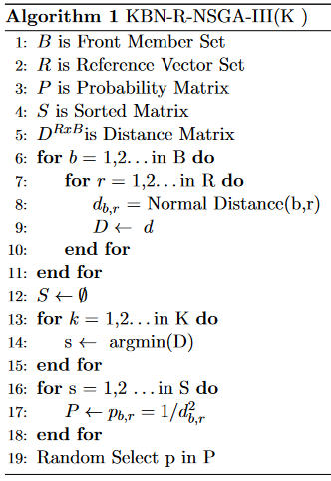
Steps 6 →11: Obtain distance matrix of every individuals to every reference vector
Columns → individual
Each row contains distance from every individual to one reference vector
New row a reference vector
Steps 12 →15: Sort the distance matrix
The entire matrix does not have to be sorted.
The kth minimum needs to be found
Select k best minimum sorted set
Steps 16 →18: Create a probability matrix where probability is proportional to distance
Each row is probability of acceptance for all individuals corresponding to a reference vector
When an individual is selected, remove column, and update the matrix
Steps 19: Use prob matrix to select candidates

Slide 19
Experimental Design
Measuring Quality of Approximated Front → Inverted Generational Distance
Generational Distance → calculates the distance between each objective vector in the front to closest objective vector in a reference
IGD → reverses the order: calculates distance between each objective vector in the reference front and the closest objective in the approximation front
IGD+ → IGD, but also pareto compliant
Measuring Diversity
Pairwise Euclidean Distance between individuals in final approximated front

Slide 20
DataSets
DTLZ and WFG Standard Test problems where pareto front is already known
Allows us to compare our approximation of PF to known PF
Each test problem tests a different aspect
DTLZ1: investigates difficulty convergence to local POF
DTLZ2: investigates scaled performance with increasing number of objectives
DTLZ3: investigates ability to converged to one global POF, but many local PFs
DTLZ4: investigates ability to generate a wide distribution of solutions
WFG5: Multimodal
WFG6: Feature inseparability

Slide 21
Test Parameters
F(x) = f₁(x) + f₂(x) + f_{n}(x)
f_{n}(x) = ax^{n} + bx^{n-1} +....cx or some linear combination
9 Tests per Datasets
4, 9, 14 Objectives
14, 28, 42 variables
All other parameters such as shrinking factor mimicked R-NSGA-III study

Slide 22
Results

Slide 23
Algorithm Per Dataset
NSGA-III preformed better on all datasets → this is expected
Our proposed K best Candidates-R-NSGA-IIII method was unsuccessful in showing any improvement on all datasets
except DTLZ3 for front approximation
Except 14 objective for diversity
DTLZ3 tested ability to get stuck in local optima
Stochastic updating avoids local optima
Something about increased objectives that made diversity calculations improve?

Slide 24
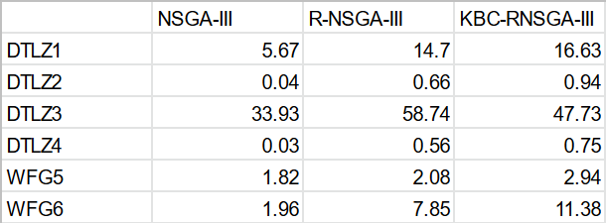
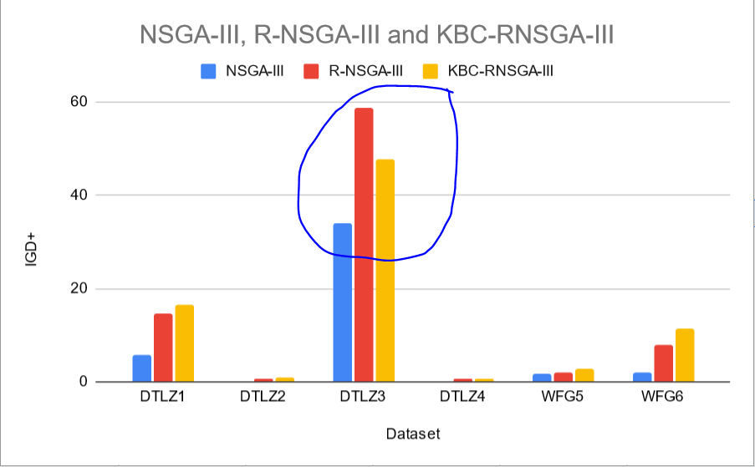

Slide 25
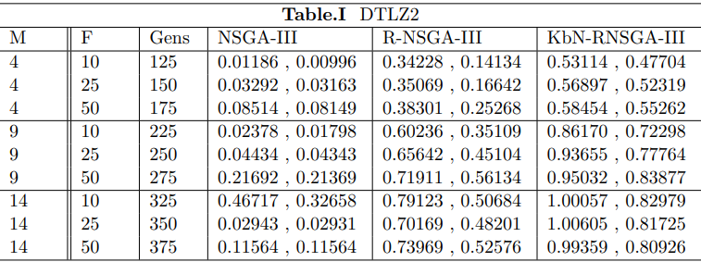

Slide 26
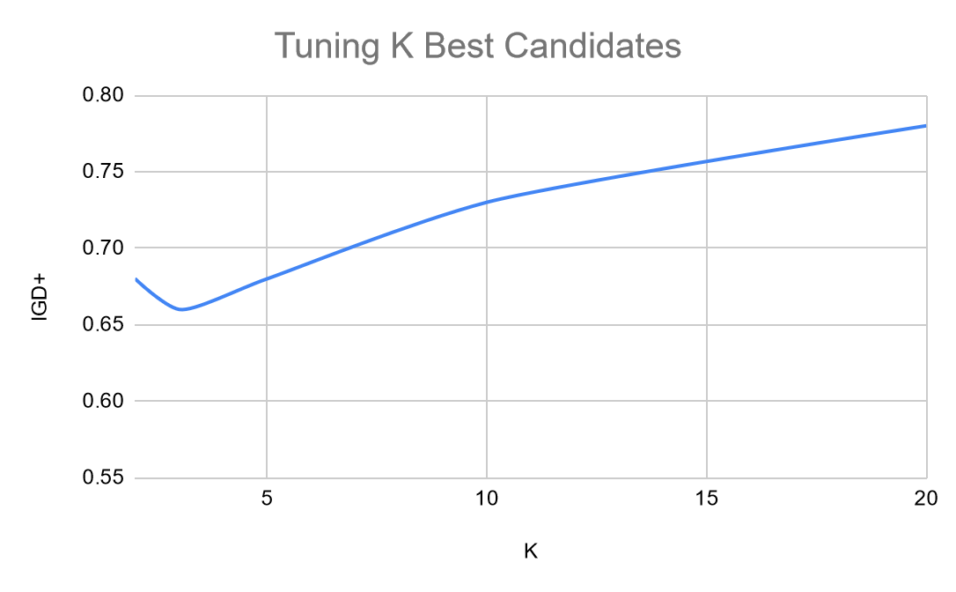
Tuning KBN - R -NSGA - III
Optimum was K = 3
Performance degraded with increasing K
Lower IGD indicates better performance

Slide 27
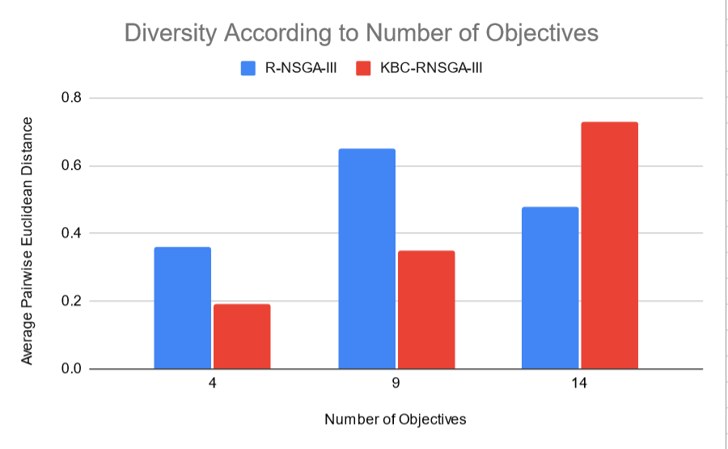

Slide 28
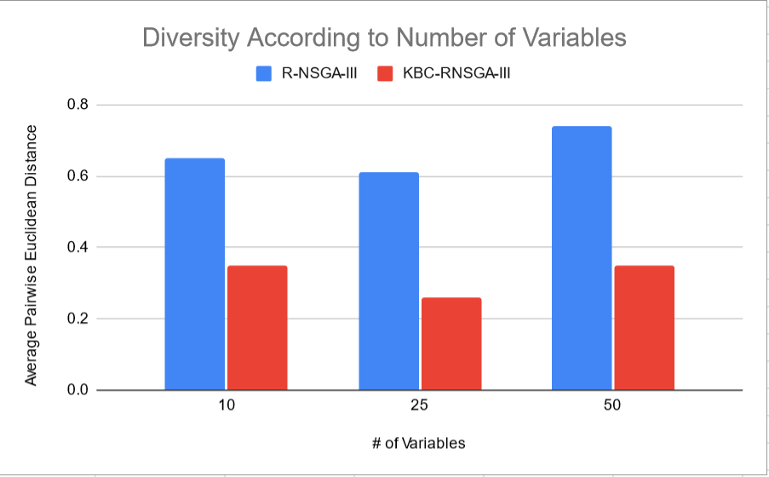

Slide 29
What went wrong?

Slide 30
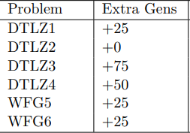
Limitations: # of Runs
Generations:
Strong Dependence of results on number of generations
Studies on NSGA-III and R-NSGA-III often used 10x more generations
Somewhat arbitrary selection of generations
Our approach was systematic
More intelligent needed
Statistically Significant: I did not do significance testing:
I only ran each table 3 times.
I would need much more to do significance testing
Calculating each table was very slow
Result → Different runs produced strong variation in the results
Notes:
Every individual represents a solution.

Slide 31
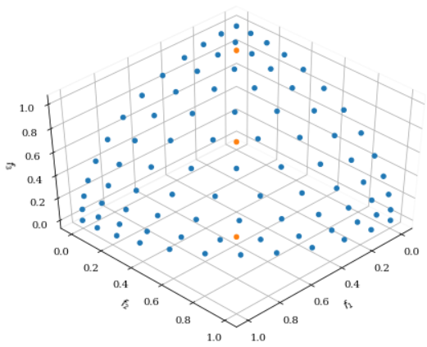
Limitations: Prior
Aspiration Point Selection:
Results of R-NSGA-III and KBN-R-NSGA-III highly dependent on the location of aspiration point
If aspiration point starts at favorable point → lower IGD
If aspiration less favorable → higher IGD
We set the aspiration point to the origin.
Different Datasets Reacted differently
We experimented with # of aspirations points
Accuracy increases with number of aspirations points, unless an aspiration point is very off
Picture of 3 objective DTLZ2. Blue is reference vector. Orange is aspiration point. Points near middle have less reference points. Points near edges have more reference points

Slide 32
Conclusions
Notes:
There are just so many things I wanted to try

Slide 33
Usefulness of KBC-R-NSGA-III algorithm
Accuracy of approx PF performs better in the face of local optima
Otherwise, performs worse
Modify R-NSGA-III to run K-Best Candidates in the face of many local optima
Introduce an optional parameter K
Tuning K will likely not be difficult because it is discrete and degrades in performance with more candidates
KBN-R-NSGA -III had lower diversity on all tests except 14 objectives
Notes:
Every individual represents a solution.

Slide 34
Future Work
Notes:
There are just so many things I wanted to try

Slide 35
When to use R-NSGA-III vs KBC-R-NSGA-III
Fair Comparison Needed: R-NSGA-III avoids much computation, we hypothesize that if R-NSGA-III was given a fair proportional increase in generations, it would match NSGA-III
Count average number of extra generations it would take for R-NSGA-III to match IGD value of NSGA-III
Count the total number of individual evaluations in R-NSGA-III vs NSGA-III
Plot total number of evaluations of each algorithm against IGD
Notes:
Every individual represents a solution.

Slide 36
More Intelligent Selection of Candidates
R-NSGA-III → picks closest candidate to reference vector
KBN-R-NSGA-III → stochastically picks k best candidates to avoid getting stuck in local optima
More intelligent approach → experiment methods with picking the right candidate
The candidate that we pick will have consequences in future generations
Enforce Diversity of distribution of objective values rather than diversity of distance
We care less about distance from reference vector and more about quality of gene pool
We only need to ensure there is diversity for crossover
We eliminate repetitive genes in the gene pool
Markov Chain: find out which was the best candidate to choose
Compare k best candidates, see which one has a better discounted effect

Slide 37
More Intelligent Diversity of Final Points
KBC-R-NSGA-III had less diversity than R-NSGA-III
Because we relaxed the enforcing of individuals to be near the reference vectors.
The reference vectors jobs was to ensure the points are discretized and well spaced
Combine Best of Both Methods: Continue probabilistic selection of candidates as usual and then enforce minimum distance in the the last generation or last k generations
Diversity of gene pool during algorithm
Orderly well spaced points in the final result

